Slide 1
Self-Service Kiosk 2014
A market update by an industry insider…
April 4, 2014

Slide 2
Table of Contents
Overview
What they said
What they say
What about Telemedicine and Telehealth
Bill Payment

Slide 3
Overview
We’ve seen reports from multiple groups on multiple segments describing the self-service and kiosk market, also the ATM market, also self-checkout POS. Can you log onto a modern website and not find a wide arrangement of self-service options such as Chat for example?
This summary will attempt to bring into better focus the drivers for self-service. The primary markets never change and those are Retail and Financial but there is more. Plus there are functional sub-verticals. Healthcare clinics in Walmart e.g.

Slide 4
Overview page 2
Is that Retail or Healthcare?
If I am dispensing drugs is that healthcare or robotics & vending?
In the conventional “kiosk” market, there is the perpetual perceived fading effect where it is said Mobile will subsume at some point. Mobile is predicted to subsume everything at some point for that matter.

Slide 5
Overview page 3
It was 2 years ago conventional selling (cold calls, emailing, tradeshows and qualifying leads) were positioned “obsolete” compared to the socials (Twitter & Facebook). That is probably true but like any other fact, only for a particular set of companies. A Pepsi, Apple or a Nike? Someone with a high consumer density.
Self-service and kiosks are victimized by the same misapplication of trend. For example, people prefer cash (for certain things at certain amounts at certain times).
Now how do connect that bill acceptor or dispenser to that mobile tablet (a tablet with data that is also mobile?). Hmmm…

Slide 6
What Are Analysts Saying?
Commenting on the report, an analyst from the team said: “One of the main trends witnessed in the Global Interactive Kiosks market is the increasing usage of tablets as a medium of interaction. In recent years, the big interactive kiosk machines are fast being replaced by sleek and handy tablet computers. During the forecast period, there is expected to be a major shift in the use of tablets as a medium of interaction. The use of tablets will help reduce the cost involved and portability issues related to interactive kiosks. Interactive kiosks have already been in use by various hotels and restaurants where customers can check-in, place orders, and provide feedback. This will considerably reduce the adoption of interactive kiosks by various industries. Moreover, customized software can be used in tablets for use by the end-users.”
July 2013 Research & Markets

Slide 7
What Are Analysts Saying?
The analysts forecast the Global Interactive Kiosk market to grow at a CAGR of 14.81 percent over the period 2012-2016. One of the key factors contributing to this market growth is the increase in the adoption of interactive kiosk. The Global Interactive Kiosk market has also been witnessing the use of tablets as a medium of interaction. However, rapid technological obsolescence could pose a challenge to the growth of this market.
July 2013 Research & Markets
Analysis of analysis – The research “mills” in India never get there facts right. This report lists companies with very few kiosks as dominant in the sector. The intent is to sell the report to those fat wallet companies…

Slide 8
What are Analysts saying?
Statistics point to growth. In terms of implementation rates and applications alike.
According to the North American Self-Service Kiosks report, published by IHL Group (www.ihlservices.com) in September 2013, the volume of transactions initiated at self-service kiosks is increasing at an annual rate of more than 7 percent in the North American market, with transactions executed via the devices expected to exceed $1 trillion annually by the end of 2014. Self-checkout systems accounted for 25 percent of kiosks deployed in 2012 and “other” retail kiosks accounted for 50 percent. The remaining kiosk installations centered on ticketing (14 percent), food ordering (6 percent) and check-in (5 percent).

Slide 9
Trends – What about Tablets?
“it’s no longer necessary to spend $15,000 on one large, dedicated hardware box, when they can put a $500 iPad or other tablet on a cool stand” and turn it into a kiosk, or, for about $1,000 apiece, build smaller-footprint, purpose-built micro-kiosks with displays that measure about five inches in diameter. The former perform the same functions as traditional kiosks, but consume less power and come with fewer infrastructure requirements than their larger counterparts—resulting in a lower cost of operation.
Scott Snyder, co-founder and president of Mobiquity from VSR Reseller March 2014

Slide 10
Time Magazine 2012

Slide 11
BCC Research 2010

Slide 12
IHL Research September 2013

Slide 13
Feb 12. 2014

Slide 14
Older research – Frost & Sullivan

Slide 15
Service Robots

Slide 16
Trends – in video and content affect

Slide 17
Digital Advertising

Slide 18
Software counts too

Slide 19
Smart homes

Slide 20
What does your business need?

Slide 21
Telemedicine – BCC Research

Slide 22
Telehealth – IHS Technology

Slide 23
Telehealth – Device and Service

Slide 24
August 2010 Verifone UK

Slide 25
Frost and Sullivan split out

Slide 26
Summit and Francie

Slide 27
Global Interactive Market

Slide 28
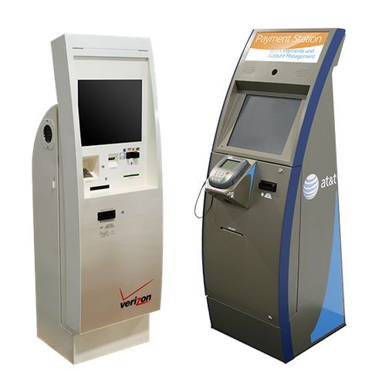
Bill Payment
Verizon and AT&T bill pay for mobile phone customers. Mobile phone customers are one of the largest segments of financial bill pay. Variation of disconnected customers from the old landline coupled with the underbanked.

Slide 29
Bill Payment Market Locations
Just for the “Big Four” telecom providers let’s say there are 10,000 retail stores and many of them have 2 bill pay machines per store. That is 20,000 kiosks at an average price of $5000. All of those come with shipping, installation, depot parts, service contracts and warranties. Figure 35%. And then there are other locations.
Other networks such as TIO Networks are in 3,000 locations
Number of Supermarket locations? 37,000 (wow…)
Easily 100,000 locations when you factor in government.
Let’s round this one off at $300 million market

